Slide 1
Writing requirements
Testing and validation platforms
Master’s Degree in Smart Energy Systems

Slide 2
Contents
Properties of requirements
Language of requirements

Slide 3
Definition
1

Slide 4
Requirements - Definition
A requirement is a singular documented physical or functional need that a particular design, product or process aims to satisfy.
A statement that identifies a product or process operational, functional, or design characteristic or constraint, which is unambiguous, testable or measurable, and necessary for product or process acceptability (by consumers or internal quality assurance guidelines) (IEEE-STD-1220-1998).

Slide 5
Requirements - Purpose
Requirements are used to:
Improve communication.
Manage complexity.
Customer
Law and standards
Requirements
Shareholders and suppliers
Sales, marketing, designer, tester, project manager, aftersales

Slide 6
Requirements - Types
Requirements
By hierarchy
By types
Business: describe high-level goals, objectives, and strategic needs of an organization.
Customer: needs, expectations, and preferences of the end-users or customers of a product or service.
System: specific capabilities, functions, and constraints that the product must fulfil to meet customer and business requirements.
Functional: describe the specific functionalities, features, and behaviours that a system must possess
Non-functional: specify the characteristics, constraints, and qualities that a system must possess
Informal
Formal
As engineers responsible for system development and validation, we will focus on this.

Slide 7
Requirements - Types
Examples:
Non-functional: The scooter shall be red.
Functional: The scooter shall accelerate from 0 to 25 kilometers per hour within 5 seconds.
Functional: The scooter shall have a minimum range of 40 kilometers on a single charge.

Slide 8
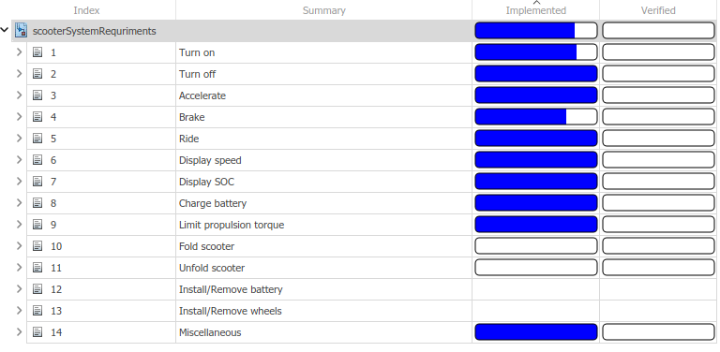
Requirements – Identification process
Define system boundary and limits
Identify users and use cases
Identify functions
Write functional requirements
Function list:
Turn on scooter.
Turn off scooter.
…

Slide 9

Requirements - Exercise
Let’s write some requirements
Taza de café de cerámica marrón y platillo.
DepositPhotos, 2013. ID:34920583

Slide 10
Properties of requirements
2

Slide 11
Requirement examples
Let’s see some requirements and discuss what do you understand:
Response time should be less than 2 seconds.
The system may perform at the maximum rating at all times, except when battery SoC is below 20 %, when it should provide 75 % of the maximum rating.
The converter must minimize losses.
The input range of an analogue input needs to have a maximum voltage of 5 V.

Slide 12
Common mistakes
When writing requirements, some mistakes are very common:
Very long sentences, requirements look like a novel.
One paragraphs contains more than one requirement. Avoid using conjunctions (and, or, but…).
Avoid subjective words like big, small, minimize, flexible maximize, user-friendly, easy, sufficient, adequate, quick…
Avoid writing conditionals: if it is necessary, in case of,…
Avoid writing implementation (HOW) and write requirements (WHAT).
If you are used to design and implement things, you will tend to write HOW things should be done.

Slide 13
Common mistakes
When writing requirements, some mistakes are very common:
Very demanding requirements:
Write numbers but also tolerances. The maximum voltage shall be 10 V ± 2 %.
Example
Some of the major horror stories of the aerospace industry deal with overly-stringent requirements. One contractor was severely criticized for charging $25,000 per coffee pot in airplanes built for the government. But the requirements for the coffee pot were so stringent, that the plane could have crashed and yet no coffee could spill. It cost a great deal to develop the coffee pot and to verify that it met its requirements.

Slide 14
Characteristics
Requriments characteristics
Feasible
Verifiable
Unambigous
Clear
Complete
Atomic
Legal
Abstract
Technically possible (cost and schedule).
Each statement can be tested. There is a feasible procedure to do so.
Each statement is precise, there are no ambiguities. There is only one interpretation.
Each statement can be understood. There are not spelling or other kind of mistakes.
The requirement defines a single traceable element.
Does not make you break any law.
The requirement does not specify a certain solution. It may be difficult in projects where a solution was already developed.
It contains all the information to understand it.

Slide 15


Feasible
Technically possible (cost and schedule)
The implementation of a requirement must be finite and cost-effective.
The system shall give full power at any speed.
The system shall give full power up to 2000 rpm.

Slide 16
Verifiable
Each statement can be tested. There is a feasible procedure to do so.
The process with which a person or machine can check that the system product meets the requirement must be finite and cost-effective.
The output of the program shall usually be given within 10 s.
The output of the program shall be given within 20 s of event X, 60% of the time; and shall be given within 30 s of event X, 100% of the time.
This statement can be verified because it uses concrete terms and measurable quantities.

Slide 17
Unambiguous
Each statement is precise, there are no ambiguities. There is only one interpretation.
The converter must minimize losses
When the converter is working at its output nominal power, the power losses shall be smaller or equal to a 5 % of the nominal output power.

Slide 18
Clear
Each statement can be understood. There are not spelling or other kind of mistakes.
The range of an analogue port needs to have a maximum tension of 5 A
The voltage range of all analogue input channels shall be between 0 V and 5 V.

Slide 19
Atomic
The requirement defines a single traceable element.
The smallest piece of information you can give that on its own is verifiable and complete.
The maximum ratings for analogue input channels shall be 5 V and 200 mA.
The maximum ratings for analogue input channels shall be 5 V and 200 mA.
The maximum input current for analogue input channels shall be 200 mA.

Slide 20
Abstract
The requirement does not specify a certain solution. It may be difficult in projects where a solution was already developed.
Since we are engineers, we may already have built something like what requirements are asking for.
Even if we known HOW to do it, write WHAT it should do.
An amplifier stage shall amplify the input voltage by a factor of 2.
The input voltage shall be amplified by a factor of 2.

Slide 21
Complete
It contains all the information to understand it. It has all the characteristics mentioned before.
Inclusion of all significant requirements, whether relating to functionality, performance, design constraints, attributes or external interfaces
The BMS shall indicate the SoC of the battery.
The Battery Management System shall indicate the state of charge of the battery numerically, with maximum jumps of 5%.

Slide 22
Language of requirements
2

Slide 23
The language of requirements
There are some standards that help us using the correct language.
We will take the IEEE Standards Style Manual as a reference.
There are some key words that appear in requirements but are not the same:
Shall
Should
May
Must
Can

Slide 24
The language of requirements
Word | Description
shall | indicates mandatory requirements strictly to be followed in order to conform to the standard and from which no deviation is permitted (shall equals is required to).
should | indicates that among several possibilities, one is recommended as particularly suitable without mentioning or excluding others; or that a certain course of action is preferred but not necessarily required (should equals is recommended that).
may | The word may is used to indicate a course of action permissible within the limits of the standard (may equals is permitted to).
can | can is used for statements of possibility and capability, whether material, physical, or causal (can equals is able to).

Slide 25
The language of requirements
The Battery Management System shall indicate the state of charge of the battery numerically, with maximum jumps of 5%.
El sistema de gestión de baterías indicará numéricamente el estado de carga de la batería, con saltos máximos del 5 %.
Bateriak kudeatzeko sistemak zenbakiz adieraziko du bateriaren karga-egoera, %5eko gehienezko jauziekin.

Slide 26
Typical requirements structures
Capability requirement
The stakeholder type shall be able to capability
The operator shall be able to switch off the machine
Capability requirement with constraints
The stakeholder type shall be able to capability
within performance of event
while operational condition.
The operator shall be able to switch off the machine within 3 seconds of overcurrent alarm activation while in rated conditions.

Slide 27
Assignment for next day
Prepare a Presentation or Video describing “What is a System Architecture”
2-4 students per team.
3 minutes.

Slide 28
References
3

Slide 29
References
Holt, J., Perry, S. A., & Brownsword, M. (2012). Model Based Requirements Engineering (Institution of Engineering and Technology, Ed.).
Hull, E., Jackson, K., & Dick, J. (2011). Requirements Engineering. Springer London. https://doi.org/10.1007/978-1-84996-405-0
IEEE Standards Association. (2021). 2021 IEEE SA Standards Style Manual. https://mentor.ieee.org/myproject/Public/mytools/draft/styleman.pdf

Slide 30
Eskerrik asko
Muchas gracias
Thank you
Jon del Olmo Larrañaga
jdelolmo@mondragon.edu
Iosu Aizpuru
iaizpuru@mondragon.edu
Paul Aretxederreta
x.paretxederreta@mondragon.edu
Galarreta Campus
Jauregi Bailara, z.g.
20120 Hernani (Gipuzkoa)
Tel. : +(34) 943 739765
www.mondragon.edu

